Slide 2
Value-based smart reminders
Finding appropriate moments for
notifications in smart reminder systems
Notes:
Thank you all for being here
Rather than ending with it, I would first like to thank supervision Birna van Riemsdijk, Willem paul brinkman & Myrthe Tielman
Road long, switched studies twice, worked for three years, dancing, many championships: nationals, european, worlds
After almost 10 years of studying, finally standing in front of you.
Grandma
Topic @ interactive intelligence
Remembering the little things, like closing and locking all doors before sleeping.

Slide 3
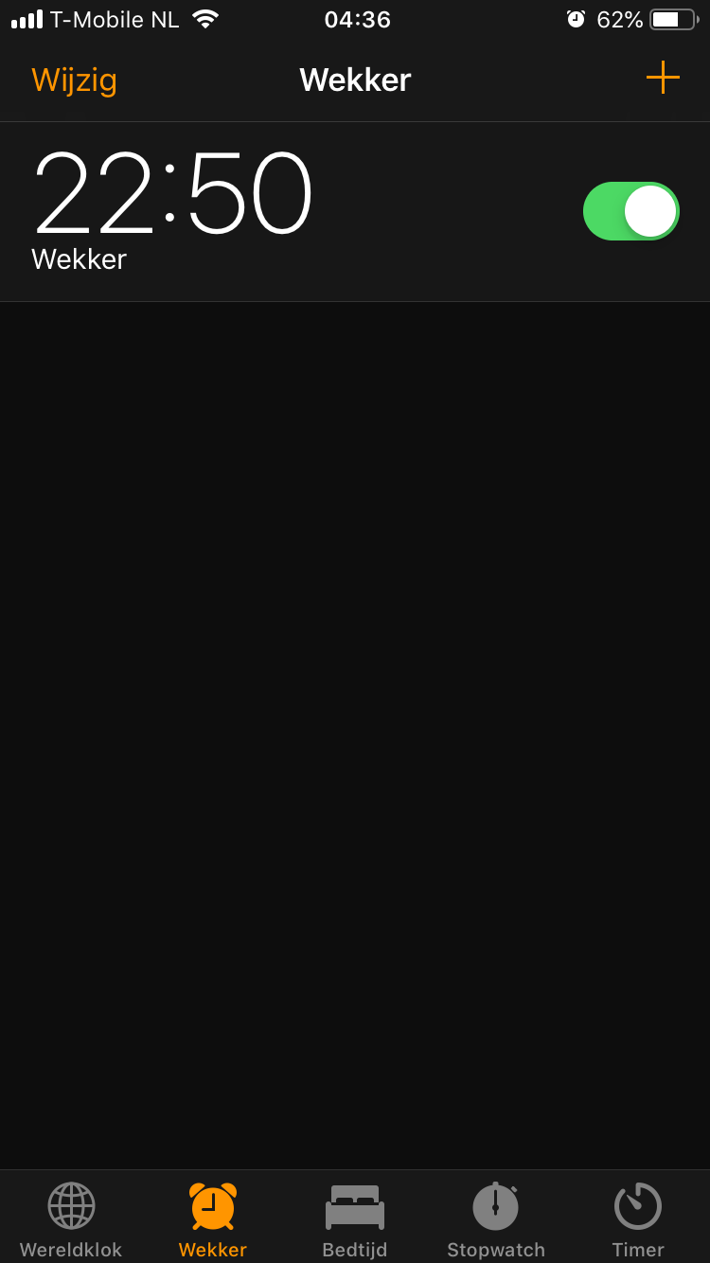
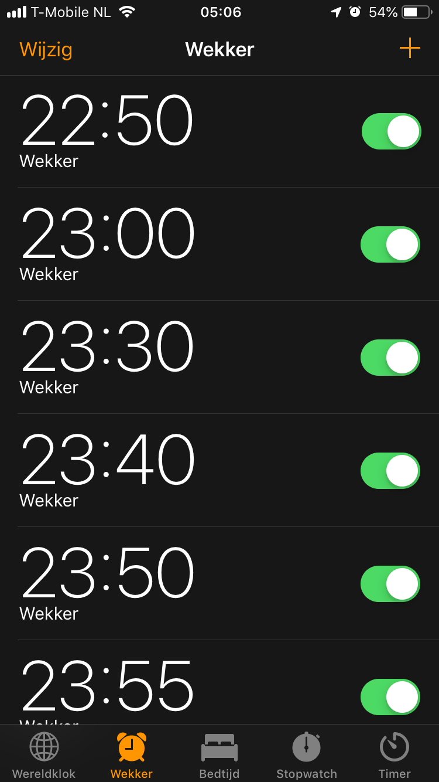
Value-based smart reminders
Finding appropriate moments for
notifications in smart reminder systems
Notes:
Simple solution alarm, which would maybe work
My case
----NEXT----
Ultimately leads to

Slide 5
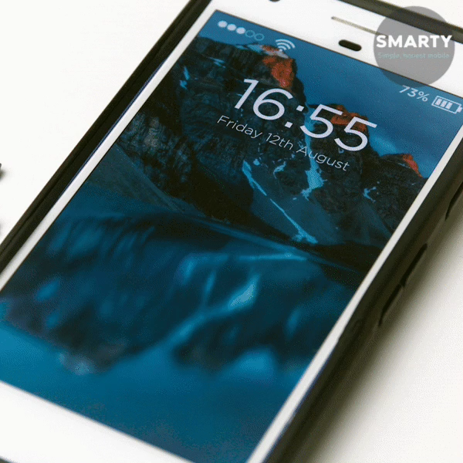
Notes:
Phone looking like this.
People who know me -> this is like my phone -> don’t respond quickly
Rather than being overloaded.
You want that right notification at the right time.
So basically like a mom.

Slide 6
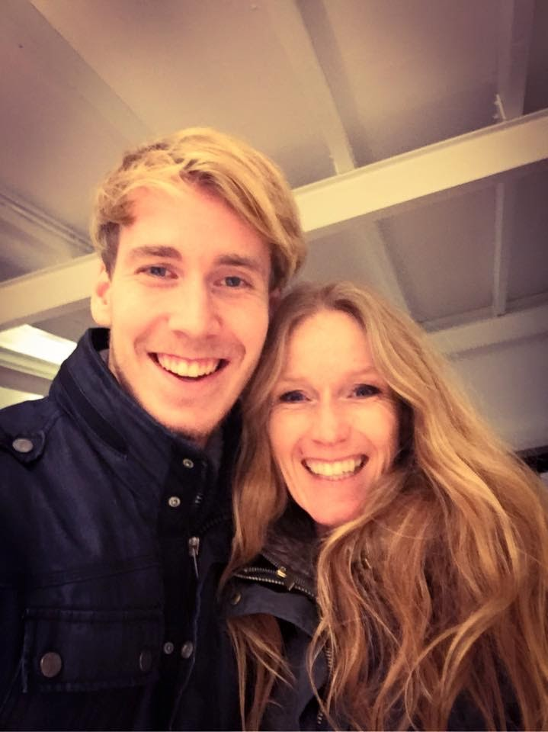

Notes:
”Sweetie, don’t forget to…”
(sorry mam)
Always right reminder at the right time. Why?

Slide 7
Values
Notes:
Humans

Slide 8
Values
Notes:
Humans

Slide 10
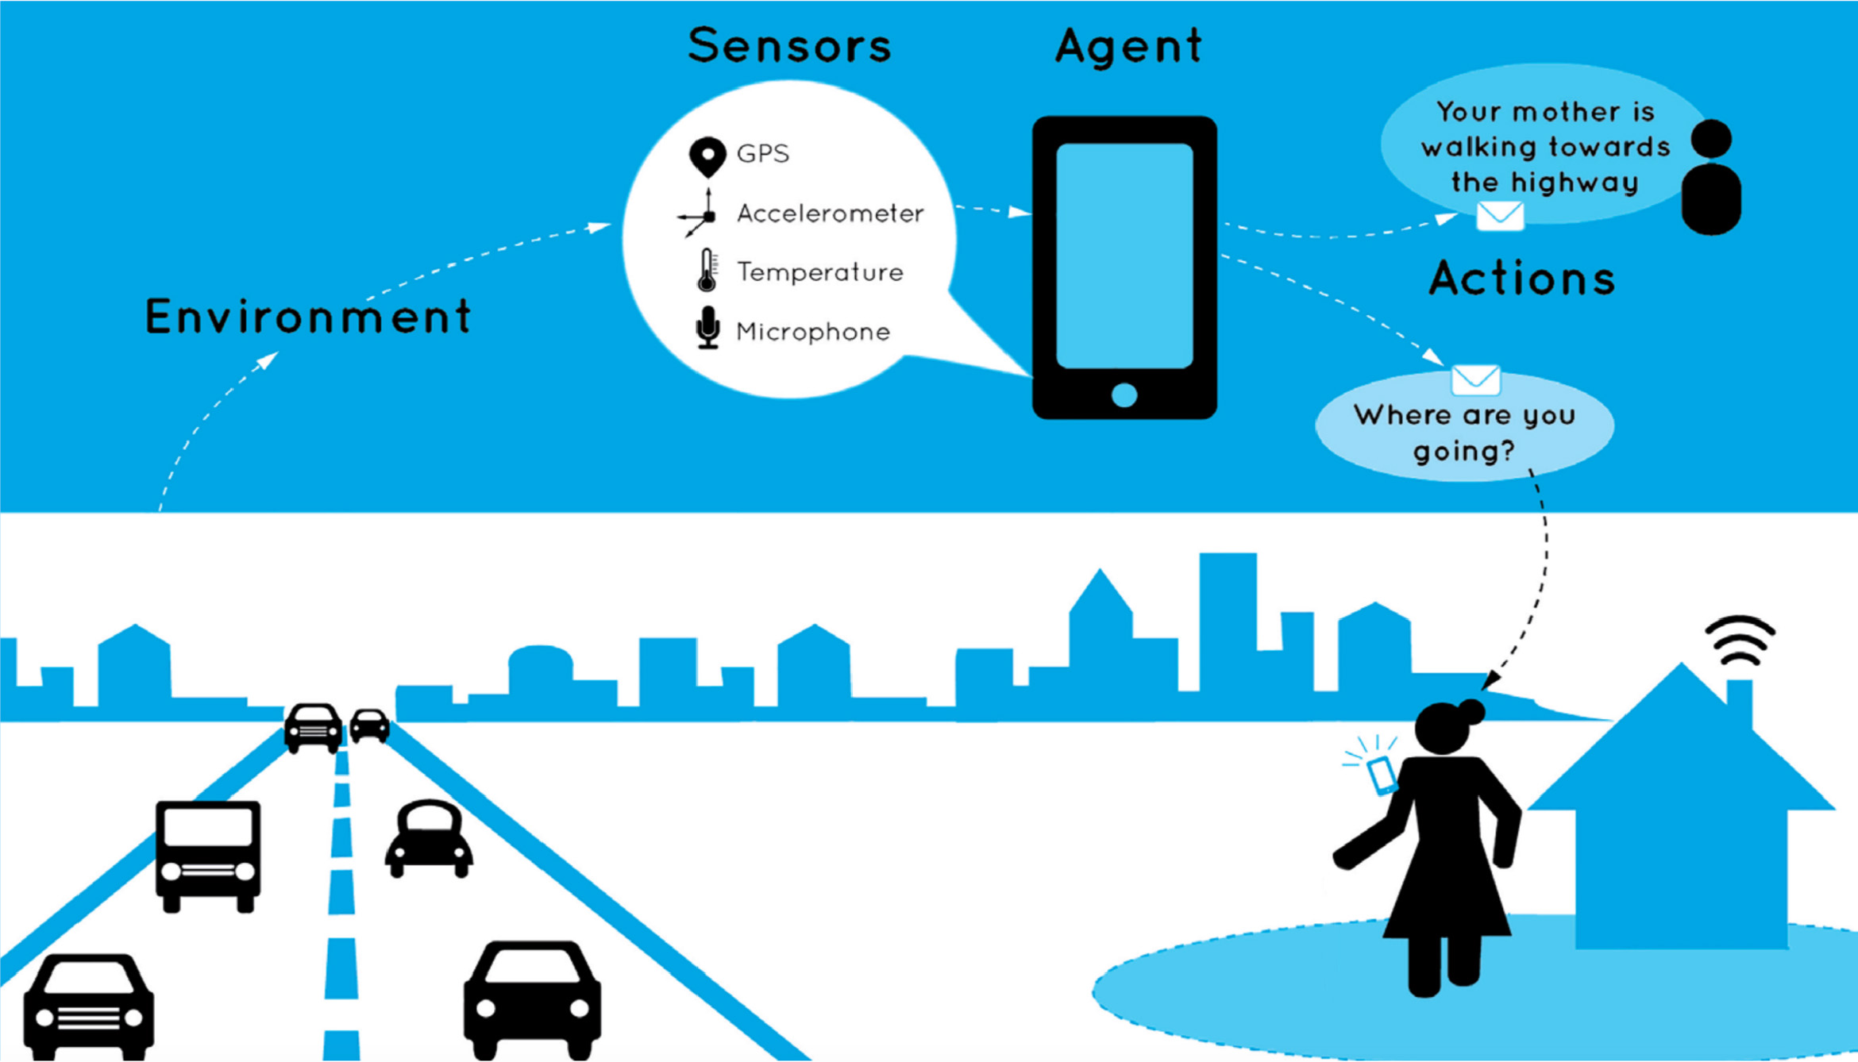

Notes:
CoreSAEP – socially adaptive electronic partner.
Broad – looking at norms and values.
Geofencing thing - too rigid
Something simpeler -> forgetting her walking cane / umbrella
Not overwhelmed with notifications

Slide 11
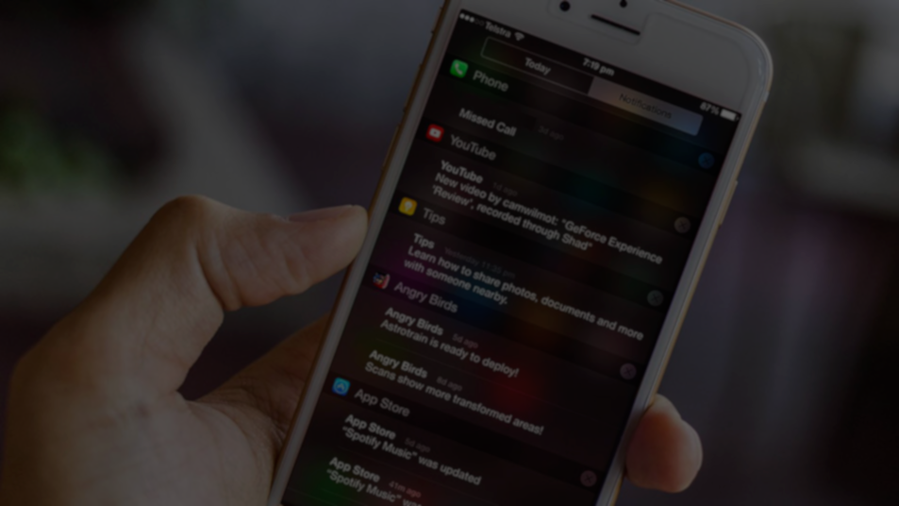
When to notify?

Slide 12
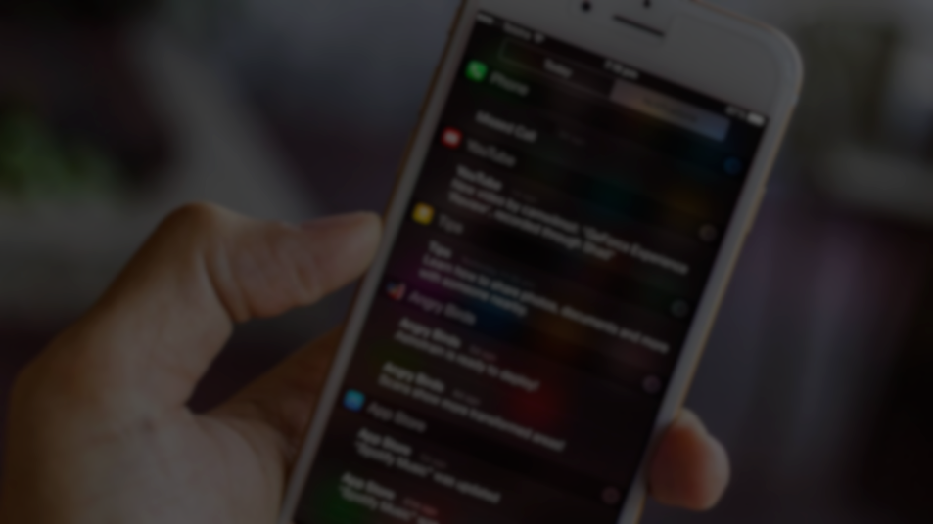
When to notify?

Slide 13
When to notify?
Values

Slide 14
When to notify?
Increase due to remembering
Values
Decrease due to notification

Slide 15
Notes:
Take existing prediction concept and extend it with values

Slide 16

Design time
<iets>
Specific setup
Non-reproducible
Notes:
Aims at combining that prediction of future activities with your values for certain activities to find the ideal moment to notify
Based on two concepts from papers
What I want from the audience:
Feedback on this method of predicting
Feedback on coupling values to activities for the choice of moments

Slide 17
Design time
<iets>
Specific setup
Non-reproducible
NotiVal
Introducing
Notes:
Aims at combining that prediction of future activities with your values for certain activities to find the ideal moment to notify
Based on two concepts from papers
What I want from the audience:
Feedback on this method of predicting
Feedback on coupling values to activities for the choice of moments

Slide 18
NotiVal
Introducing
Notes:
Combine
activity prediction
User values

Slide 19
Watching TV – Promotes Happiness
Do work – Promotes Career
07:45
8:15
08:00
09:00
Brushing teeth – Promotes Health
Eating – Promotes Health
Notes:
Assumptions: Explain that we have this in dataset or will still collect through an app
Activities directly promoting/demoting values
Notification might not ruin value, requires separate data.
Find least annoying.

Slide 20
Watching TV – Very Annoying
Do work – Unacceptable
07:45
8:15
08:00
09:00
Brushing teeth – Slightly Annoying
Eating – Slightly Annoying
Notes:
Assumptions: Explain that we have this in dataset or will still collect through an app
Activities directly promoting/demoting values
Notification might not ruin value, requires separate data.
Find least annoying.

Slide 21
?

Slide 22
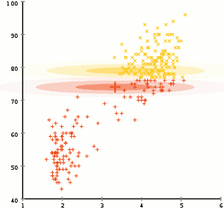
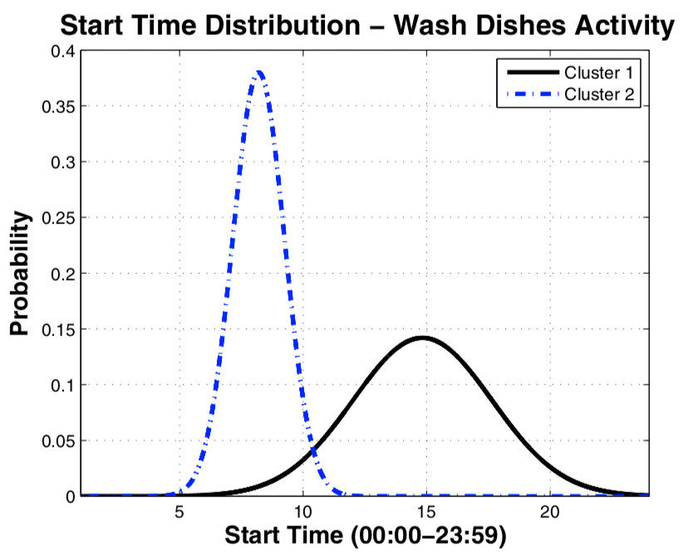
Expectation Maximization
& Apriori algorithm
Watching TV
57 %
Leaving Home
20 %
Watching TV
40 %
Showering
55 %
Notes:
Two concepts from ML
Expectation Maximization – iterative method to find best parameters for Gaussian mixture models
Apriori algorithm (datamining algorithm) to identify temporal relations
Every cluster has probability of next activity

Slide 23
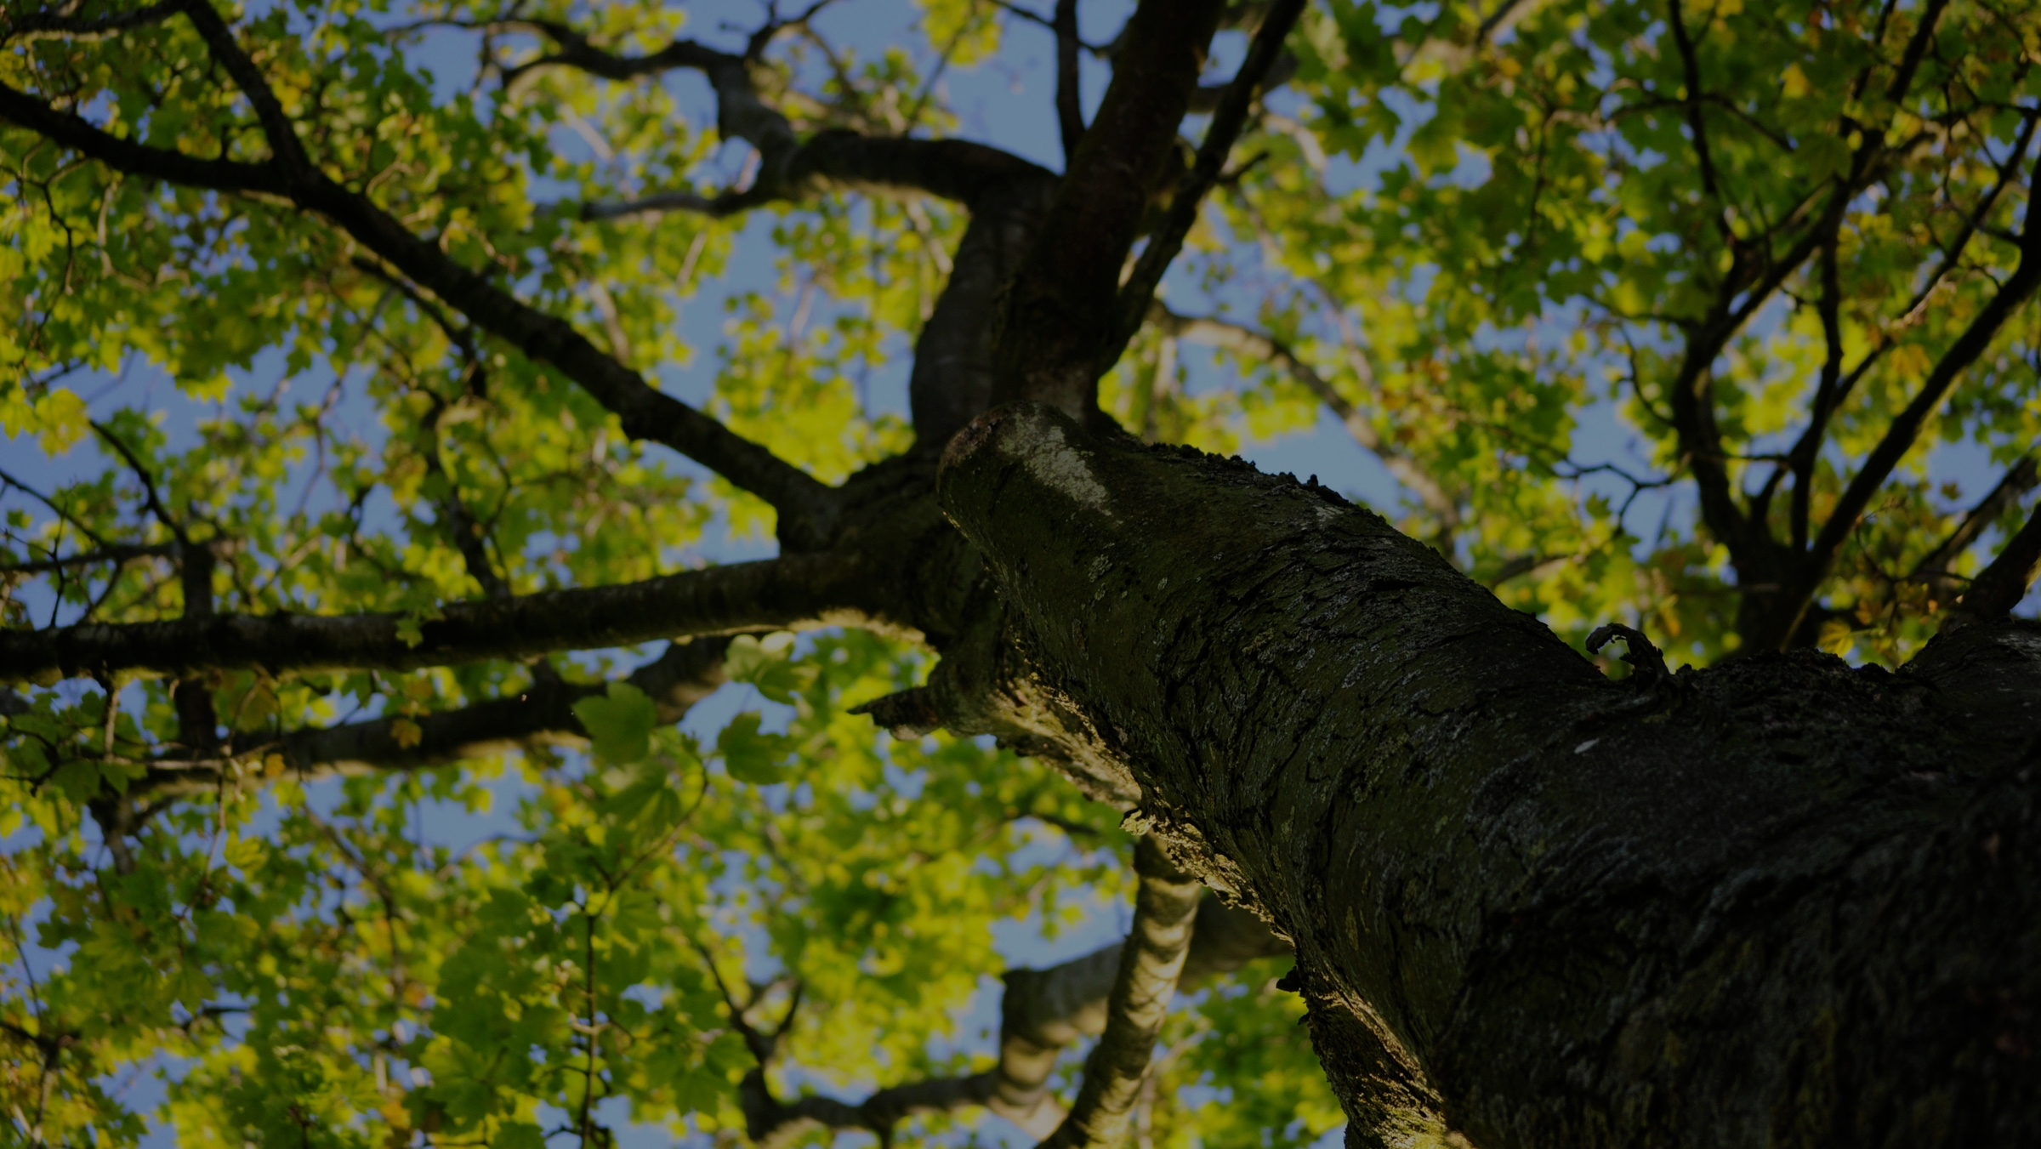
Expectation Maximization
Duration (min)
Start (h)

Slide 24
Notes:
Typical day modeled with these consecutive predictions

Slide 25
G
L
G
L
G
L
G
L
G
G
L
L
G
L
G
L
G
L
G
L
G
G
L
L
G
L
G
L
G
L
G
L
G
L
Notes:
Add values

Slide 26
Notival
Don’t forget to take your umbrella/walking stick/keys

Slide 27
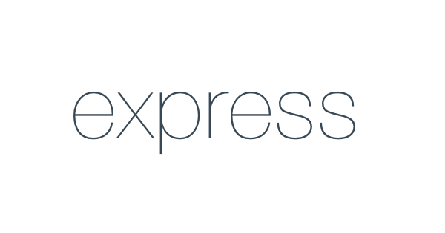
Notes:
Why do we have this? Any service or dataset

Slide 29
Value-based smart reminders
Finding appropriate moments for
notifications in smart reminder systems

